Slide 1

CSE-5335: Presentation
SIREMAR For the People of Margarita
GROUP 9
Nishank Gujar (1001861756)
Manasa Mohan Kumar (1001869268)
K S Pavan Krishna (1001935714)
Section: 5335-002
SPRING 2022

Slide 2
Introduction
Siremar is a Leading Edge Web Portal which Aims to keep a Dynamic count of all residents and provide all the necessary information to the residents of the beautiful island of Margarita located in South America.

Slide 3

Technologies
HTML (Hypertext Markup Language)
It is a standardized system for tagging text files to achieve font, color, graphic, and hyperlink effects on World Wide Web pages.
CSS (Cascading Style Sheets)
It provides the (visual and aural) layout, for a variety of devices.
ReactJS (React JavaScript)
It is a free and open-source front-end JavaScript library for building user interfaces based on UI components.
PHP (Hypertext Preprocessor)
PHP code is usually processed on a web server by a PHP interpreter implemented as a module, a daemon or as a Common Gateway Interface (CGI) executable.
SQL (Structured Query Language)
It is used to communicate with a database. According to ANSI (American National Standards Institute), it is the standard language for relational database management systems. SQL statements are used to perform tasks such as update data on a database or retrieve data from a database.
WordPress
It is a content management system (CMS) written in PHP that uses a MySQL database. In non-geek speak, WordPress is the easiest and most powerful blogging and website builder in existence today.
Laravel
It is a back-end PHP-based and open-source framework used for building a wide range of custom web applications. It's an entirely server-side framework that manages data with the help of Model-View-Controller (MVC) design which breaks an application back-end architecture into logical parts.
Socket.io
It is a library that enables low-latency, bidirectional and event-based communication between a client and a server.

Slide 4
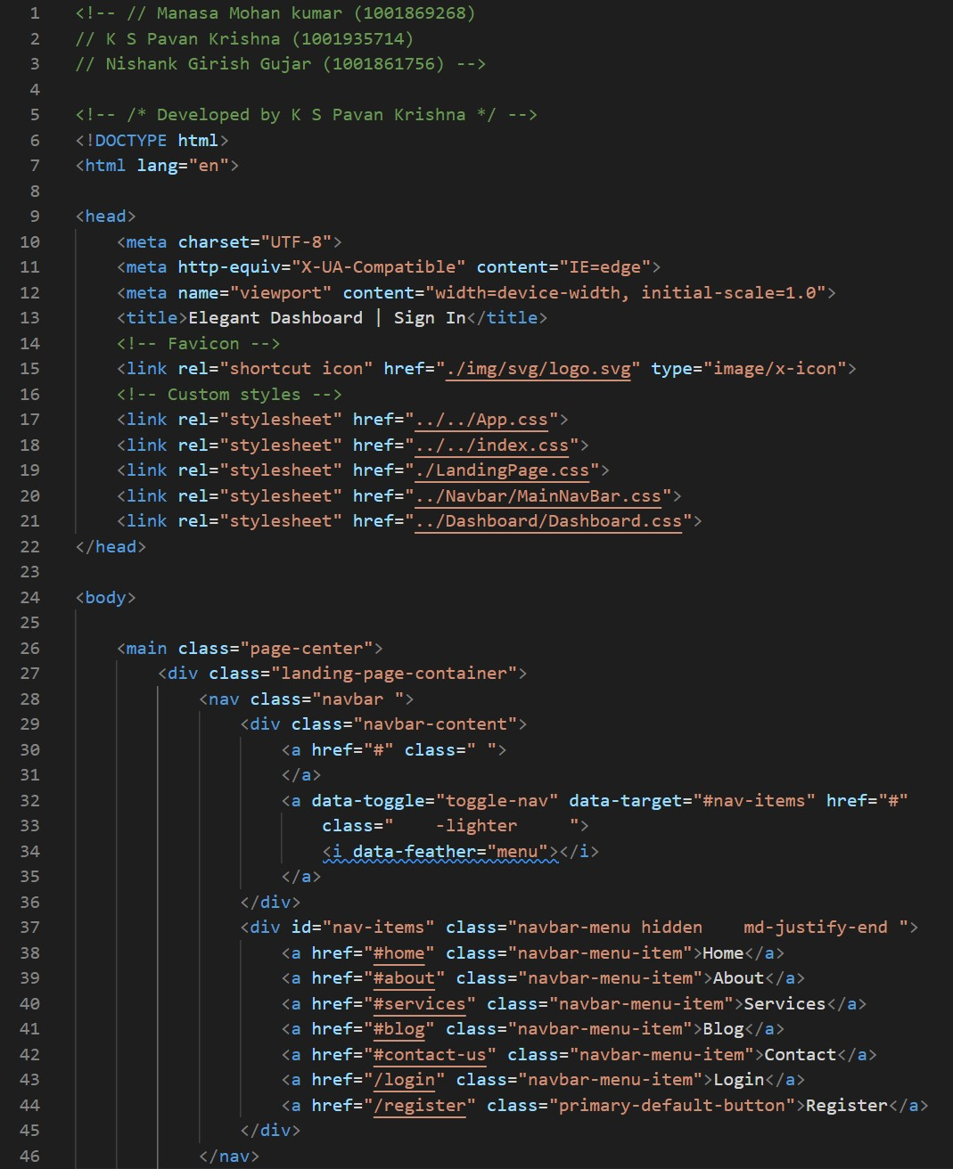
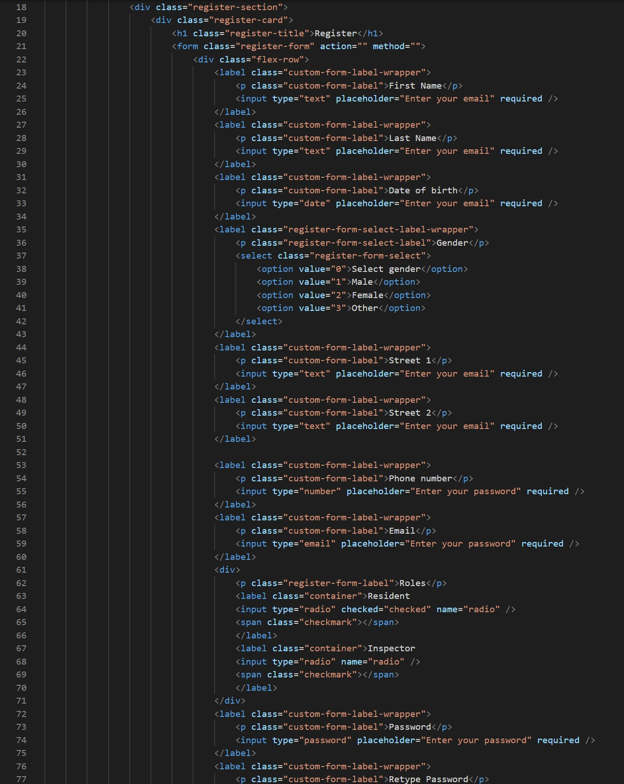
Code Snippets
HTML (Hypertext Markup Language)

Slide 5
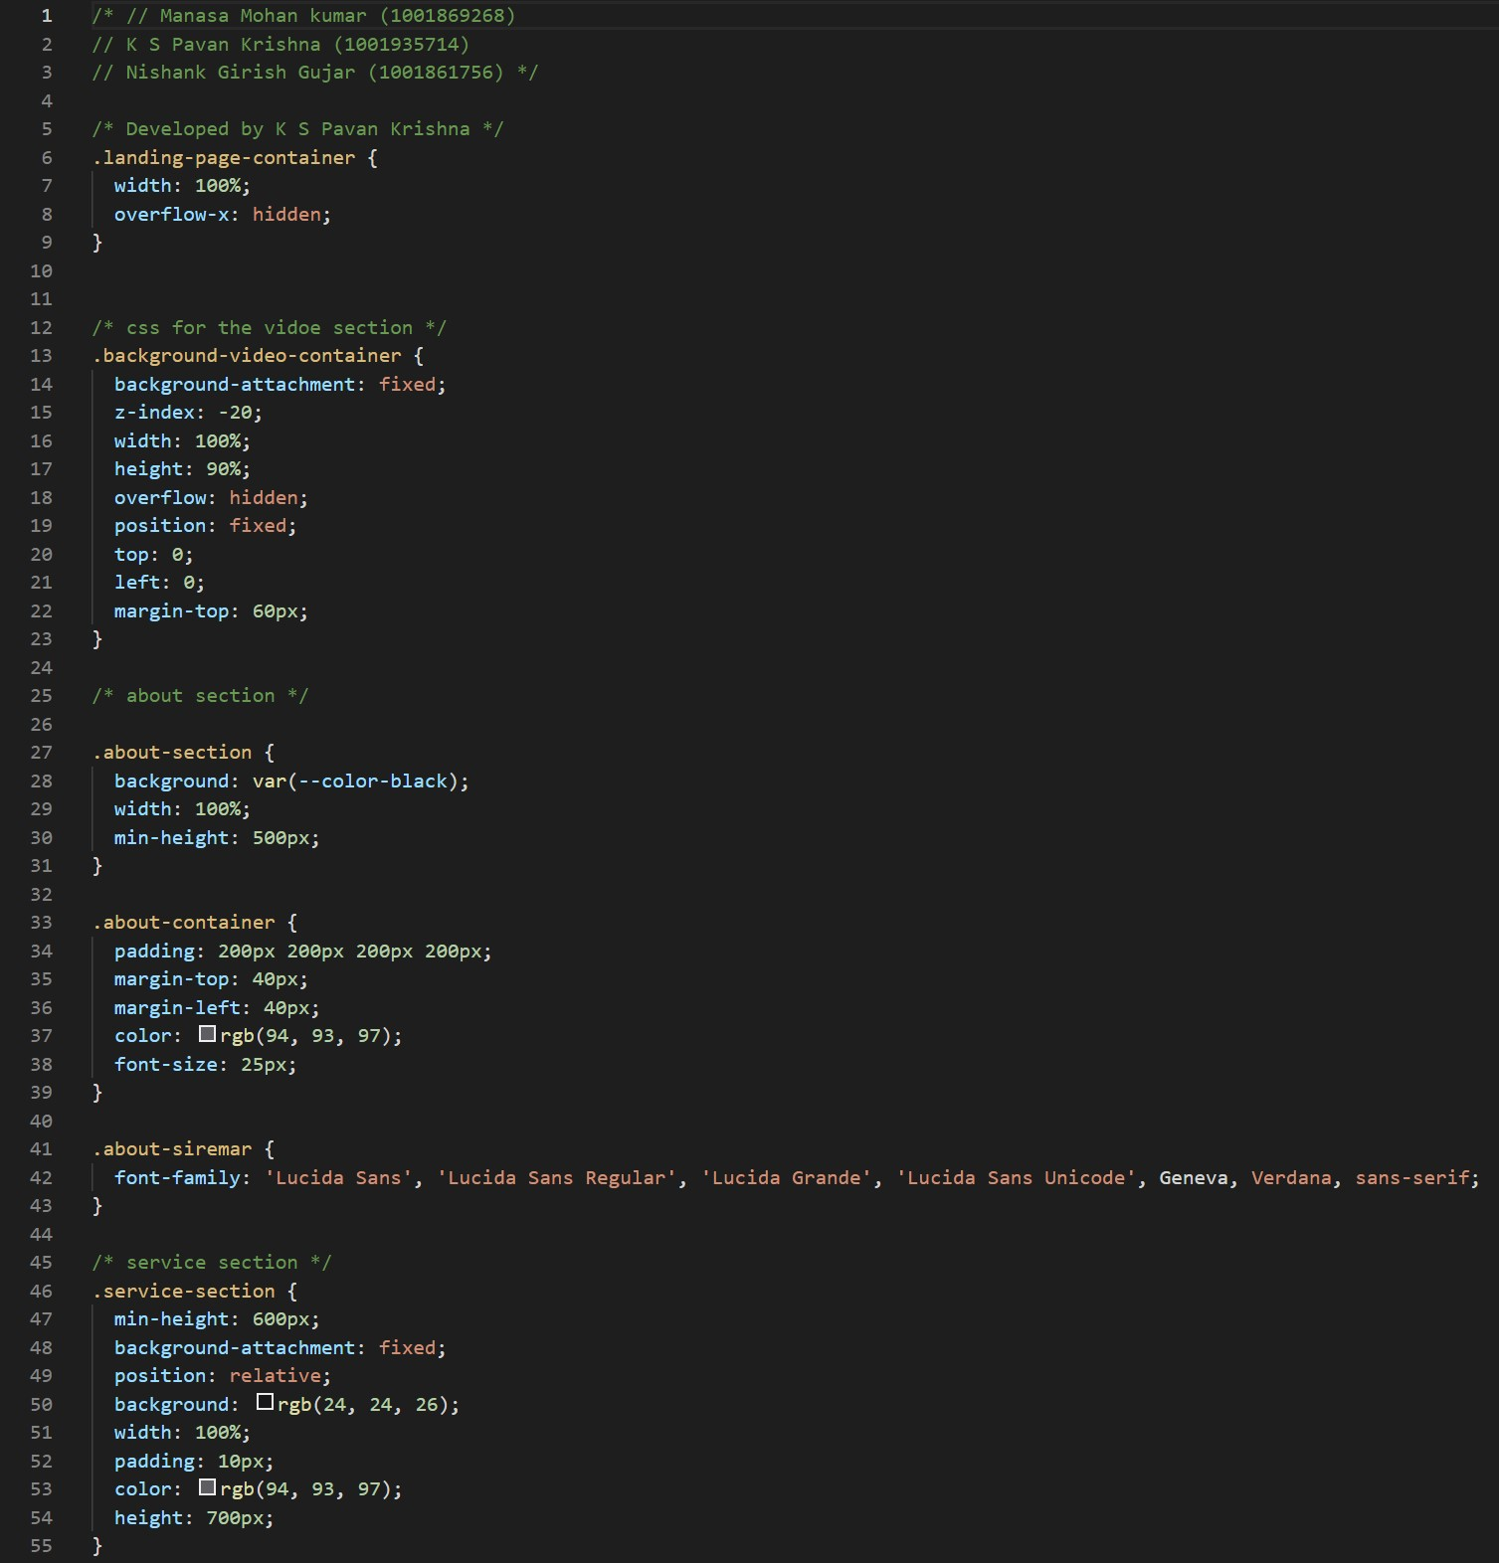
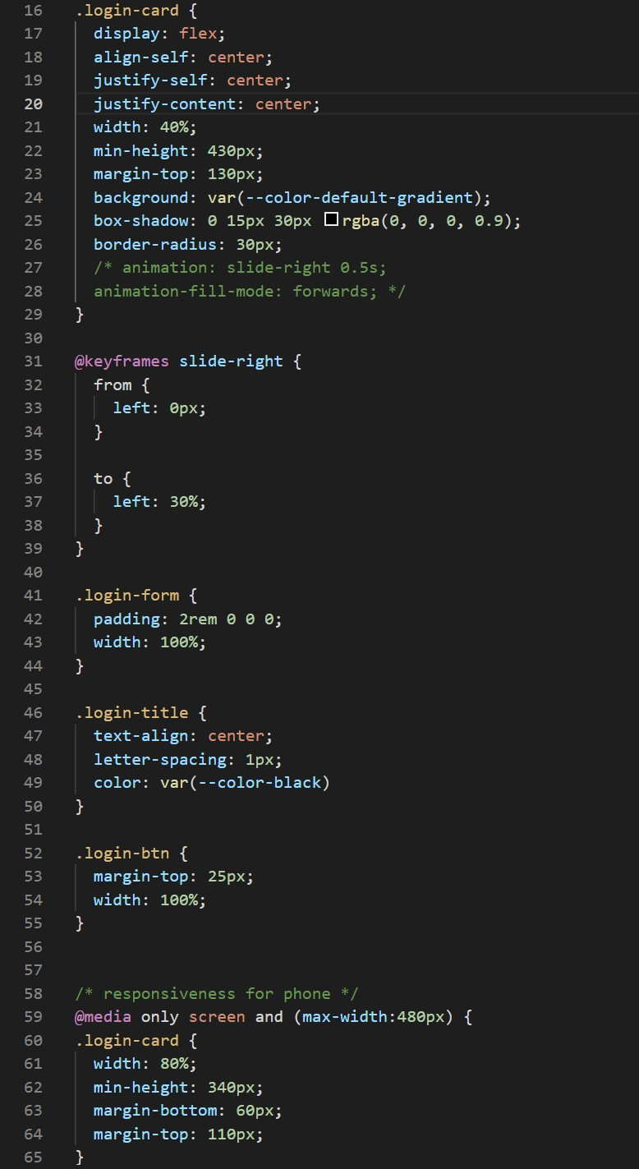
Code Snippets
CSS (Cascading Style Sheet)

Slide 6
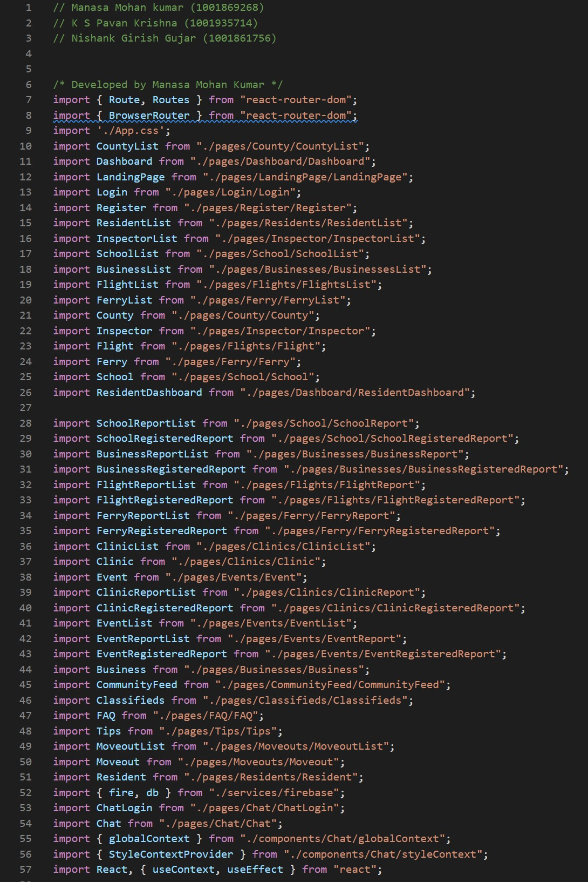
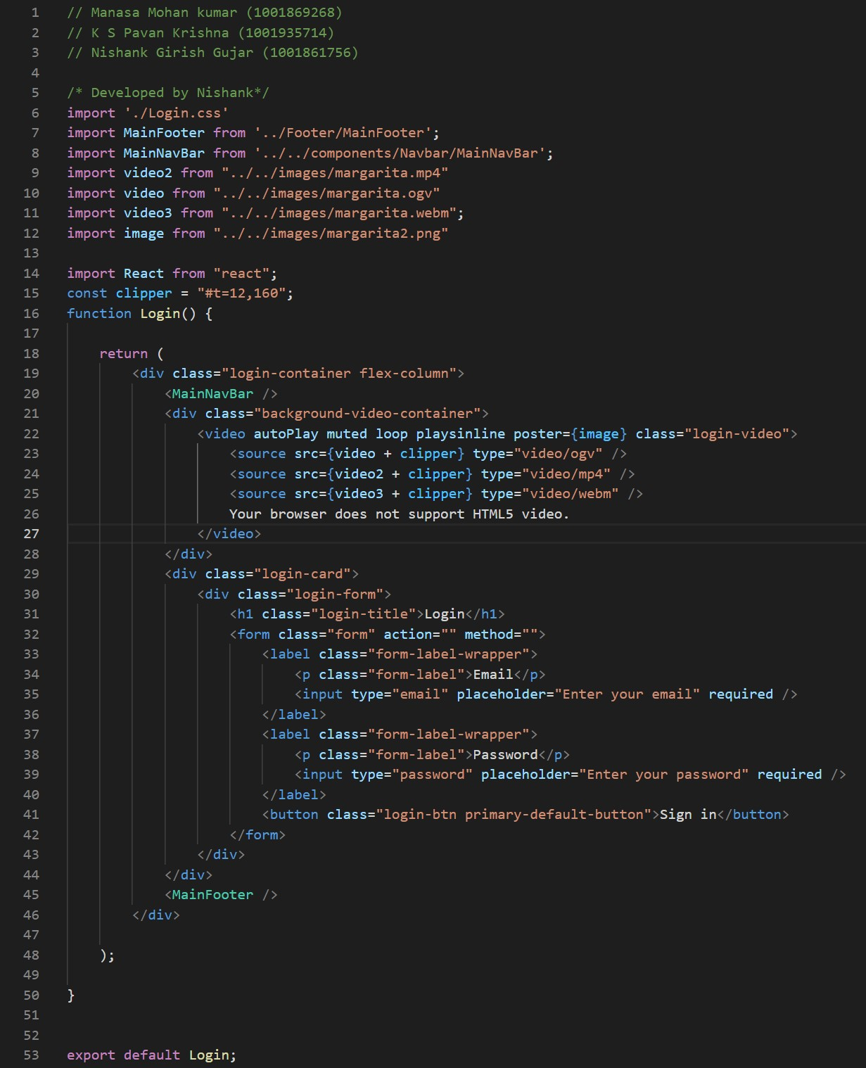
Code Snippets
ReactJS (React JavaScript)

Slide 7
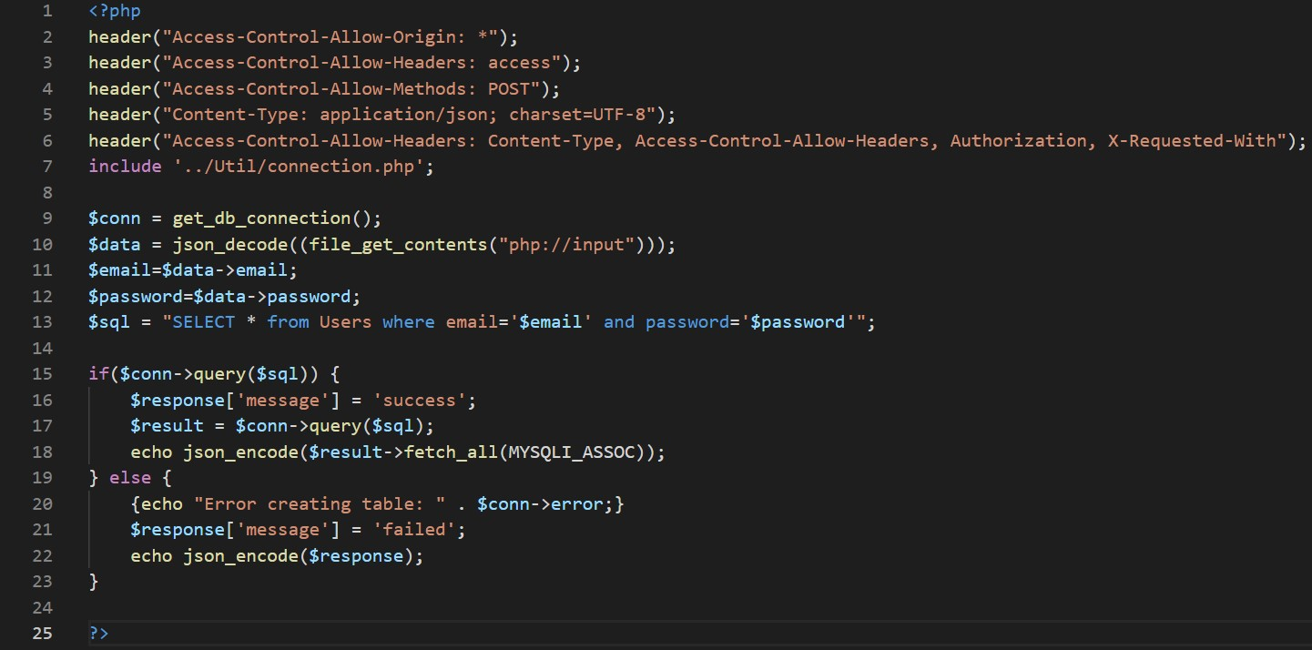
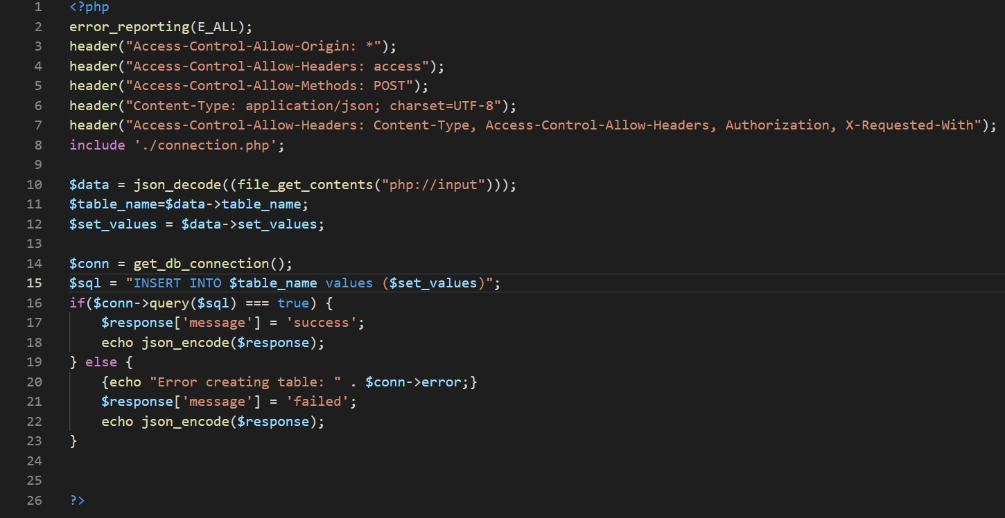
Code Snippets
PHP (Hypertext Preprocessor)

Slide 8
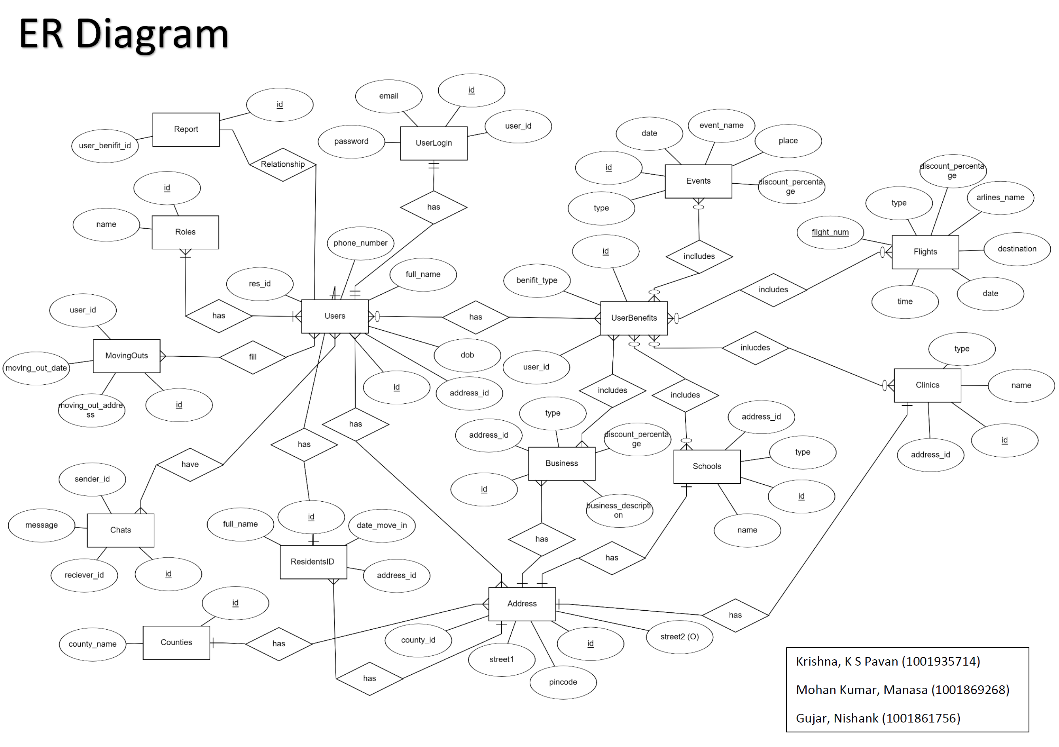

Slide 9
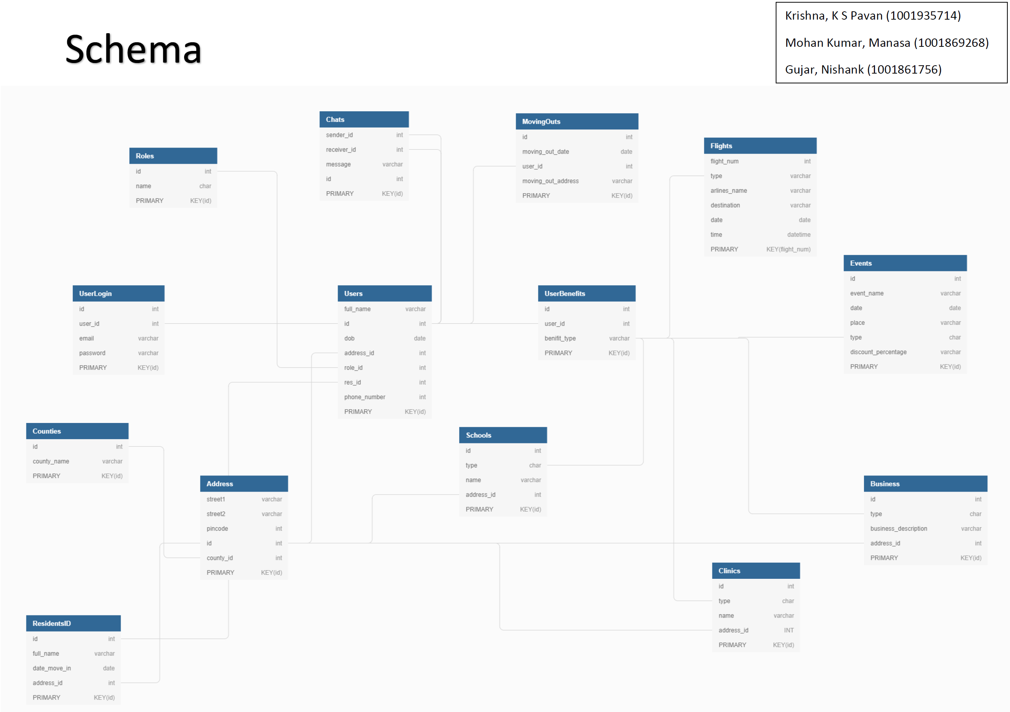

Slide 10
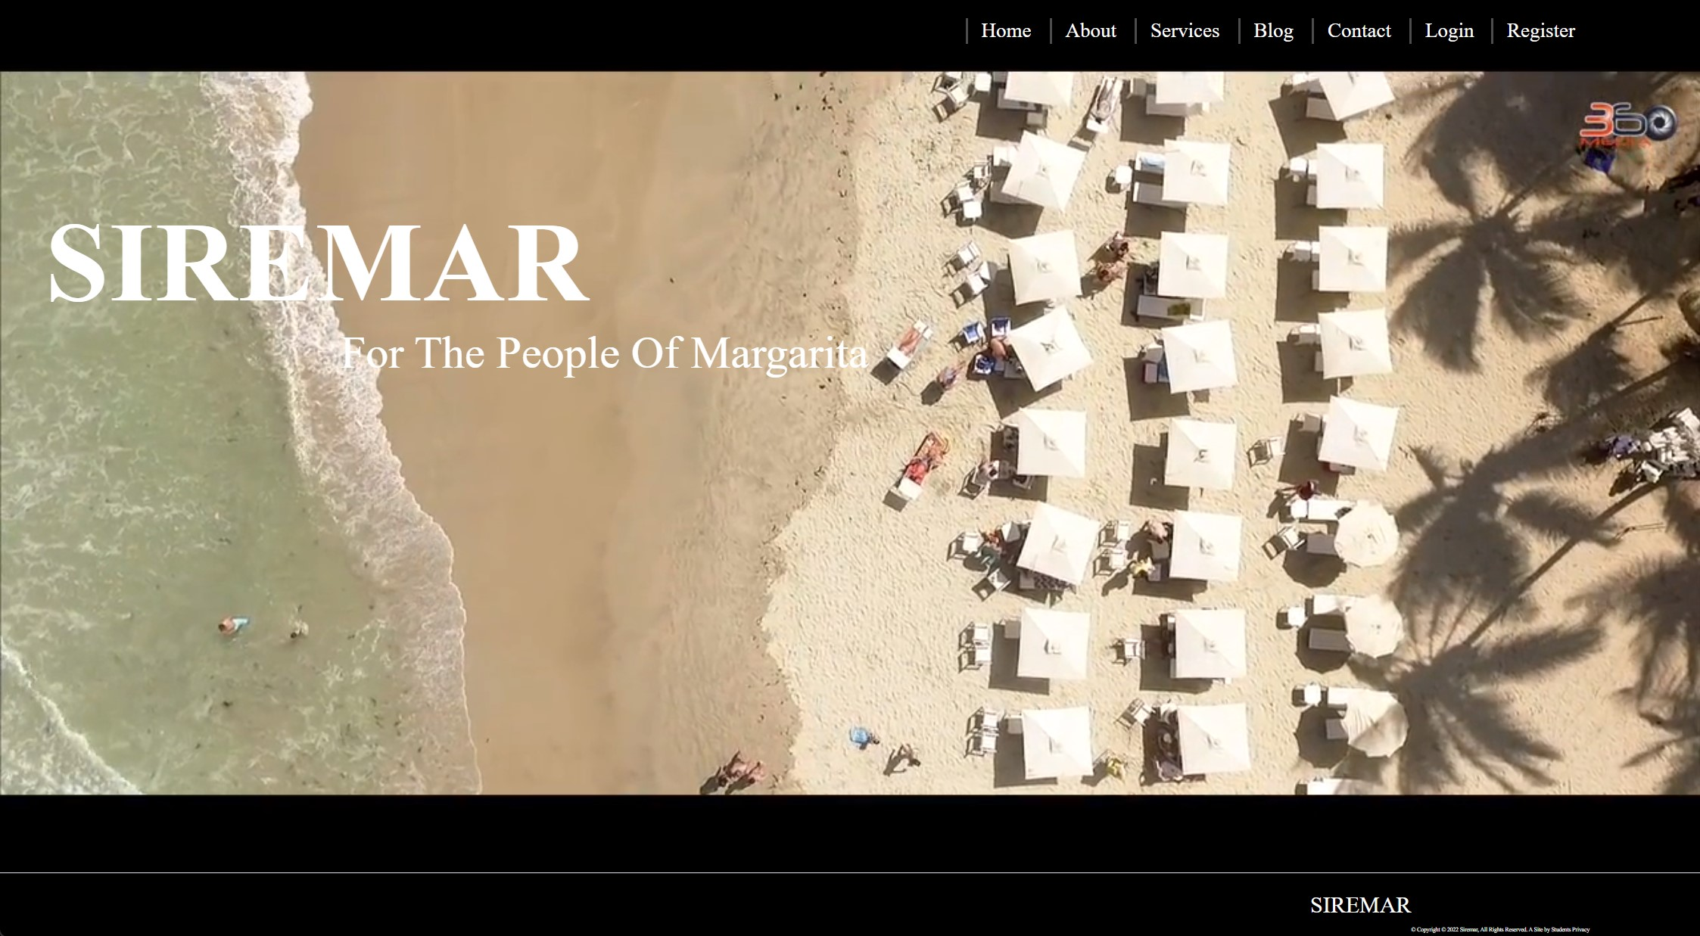
Landing Page

Slide 11
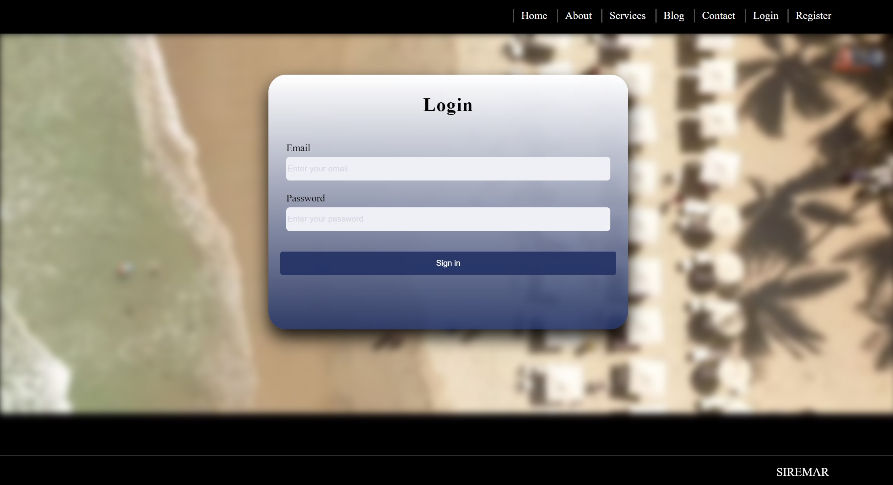
Login Page

Slide 12
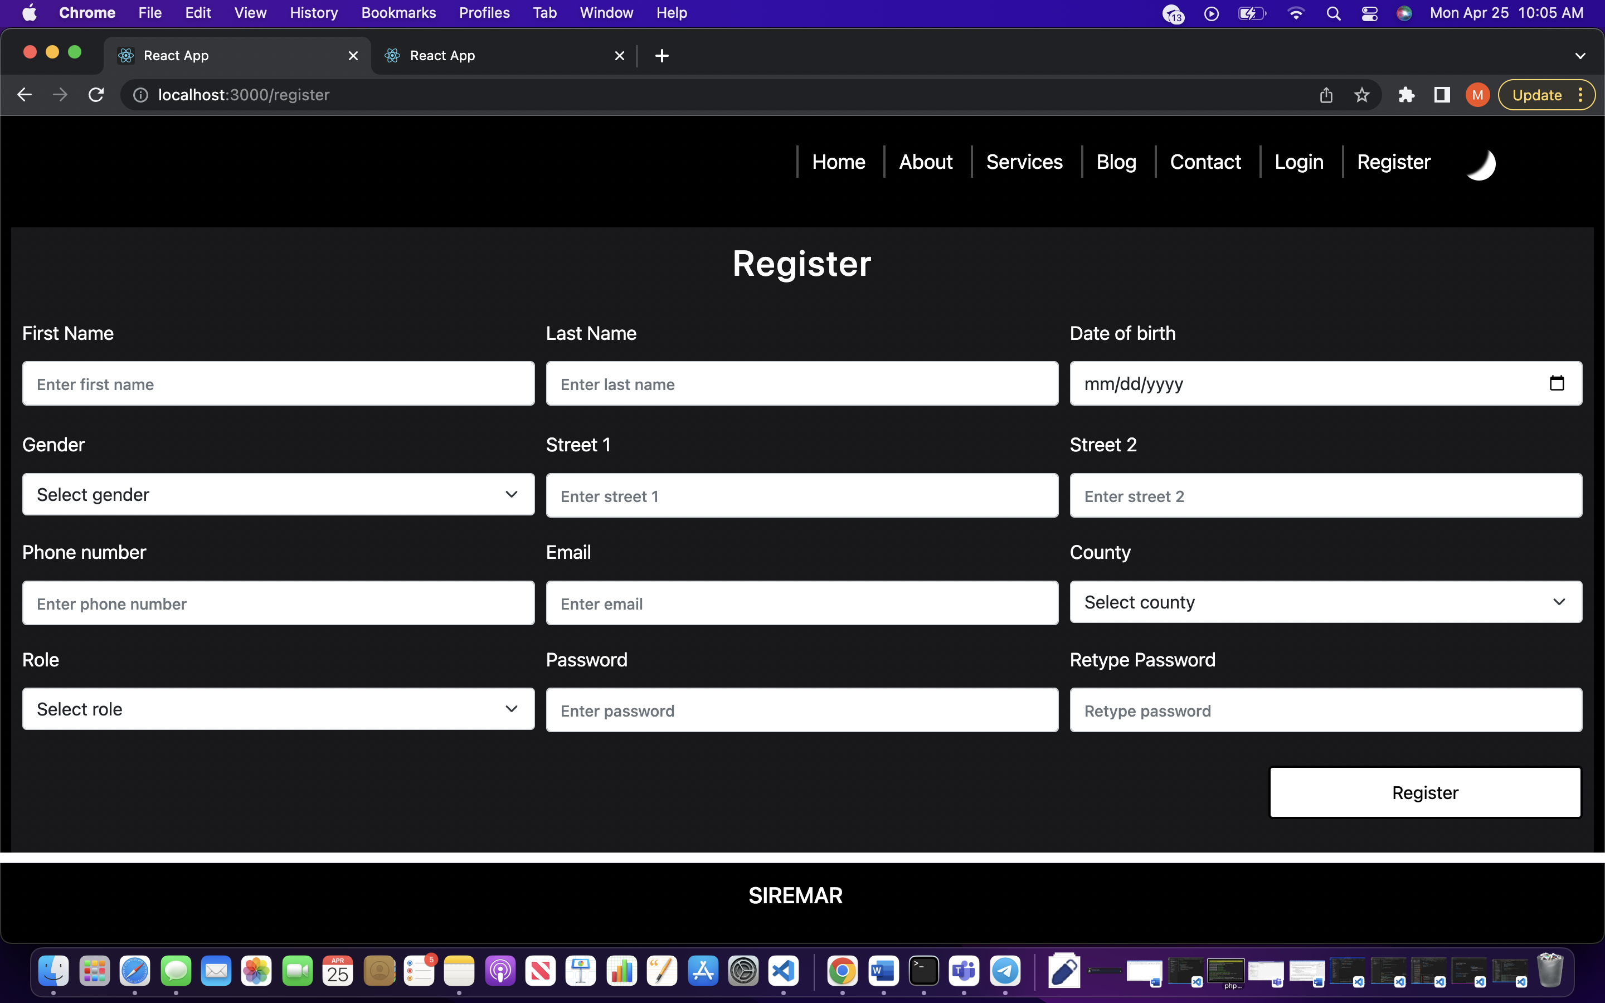
Registration Page

Slide 13
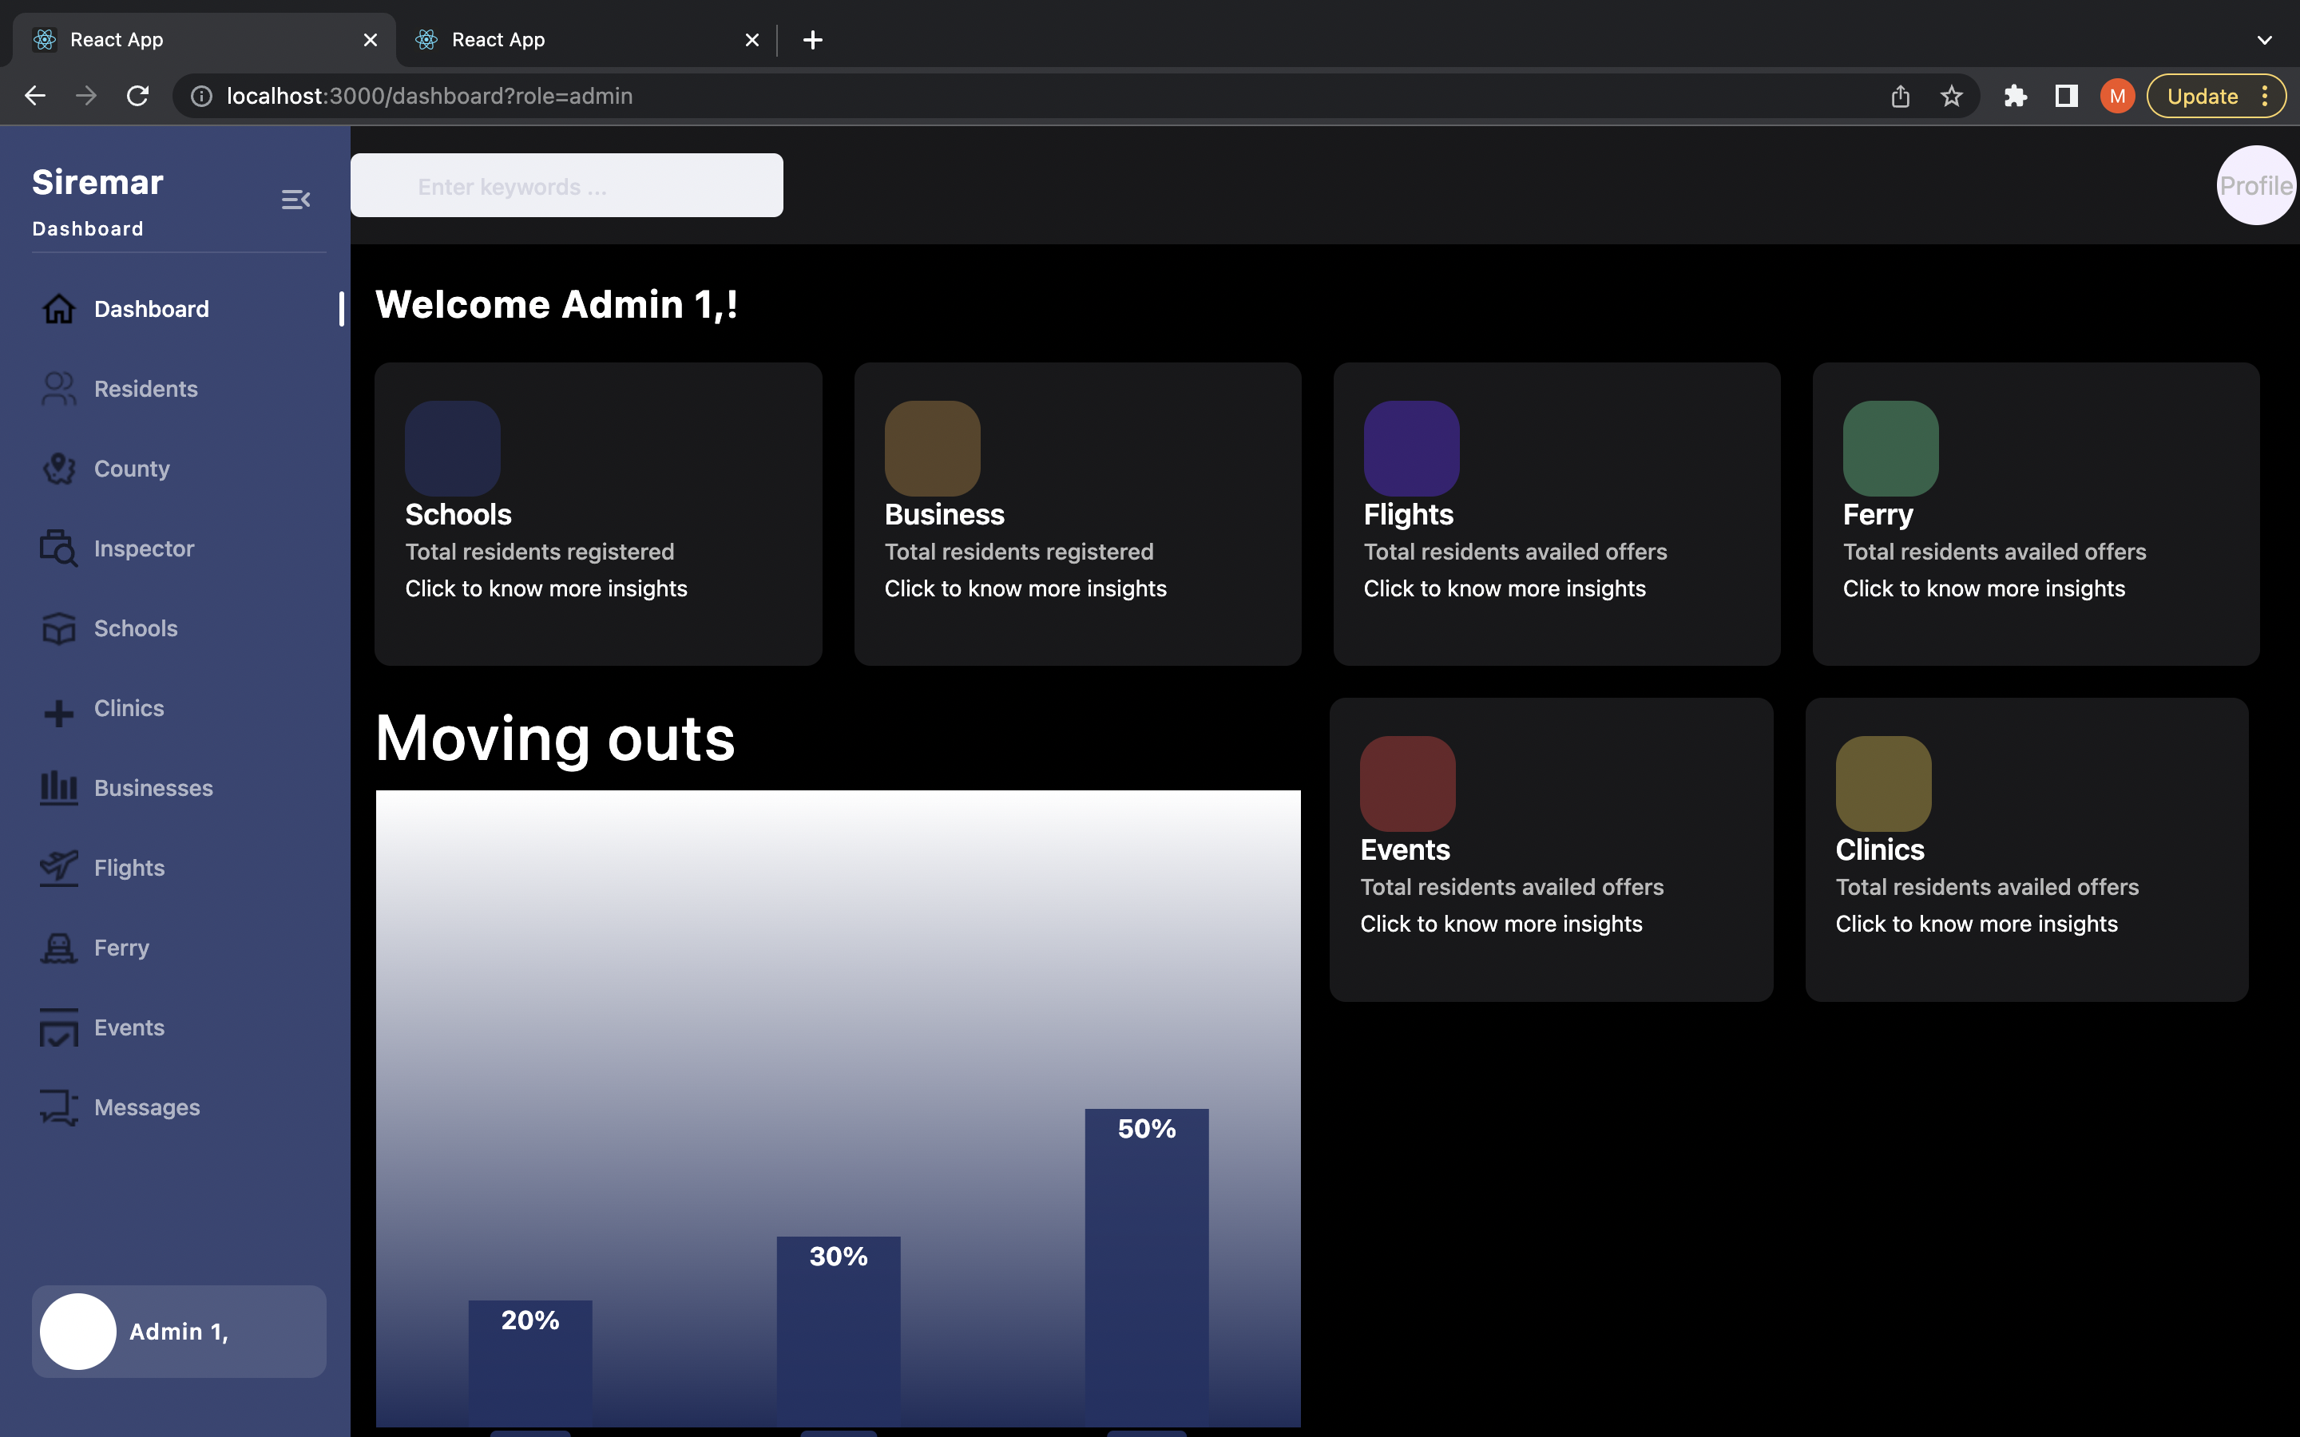
Dashboard (Admin)

Slide 14
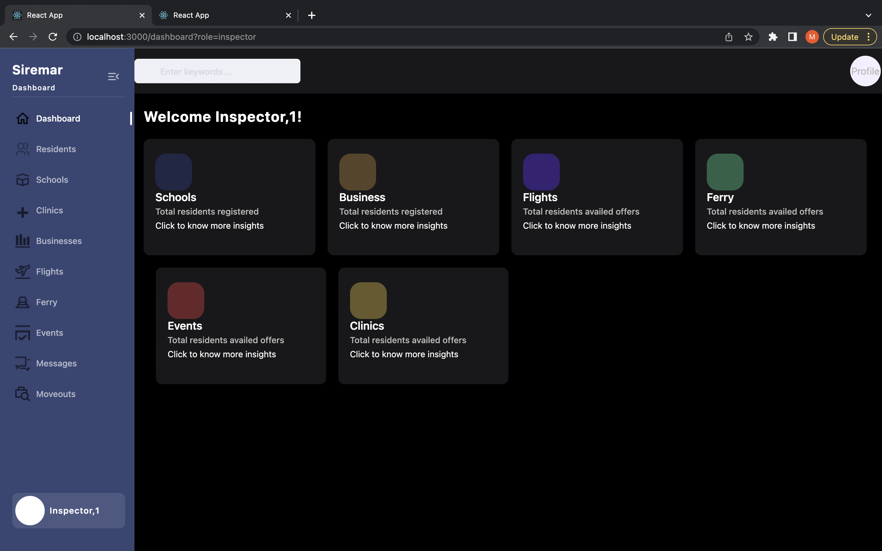
Dashboard (Inspector)

Slide 15
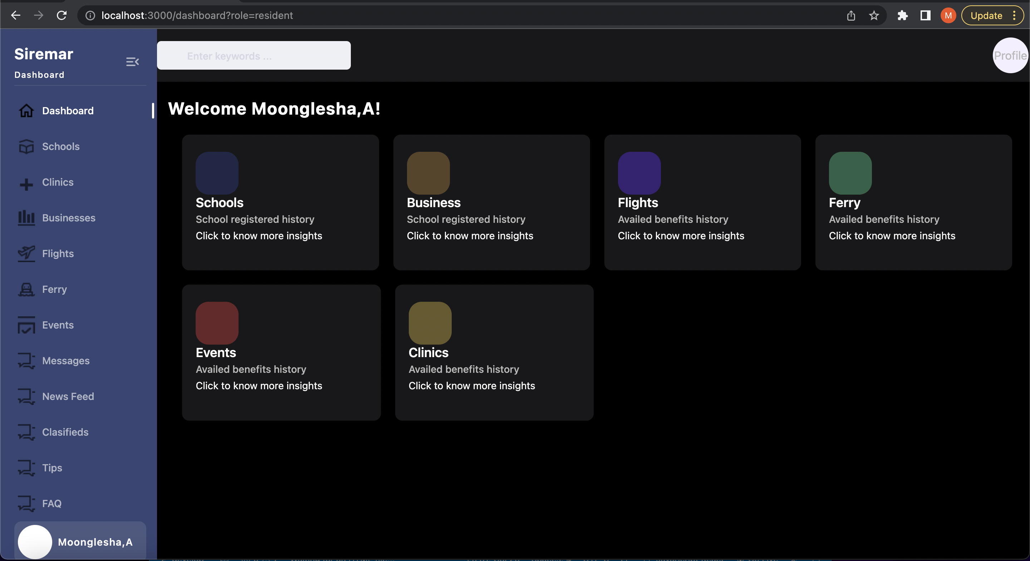
Dashboard (Resident)

Slide 16
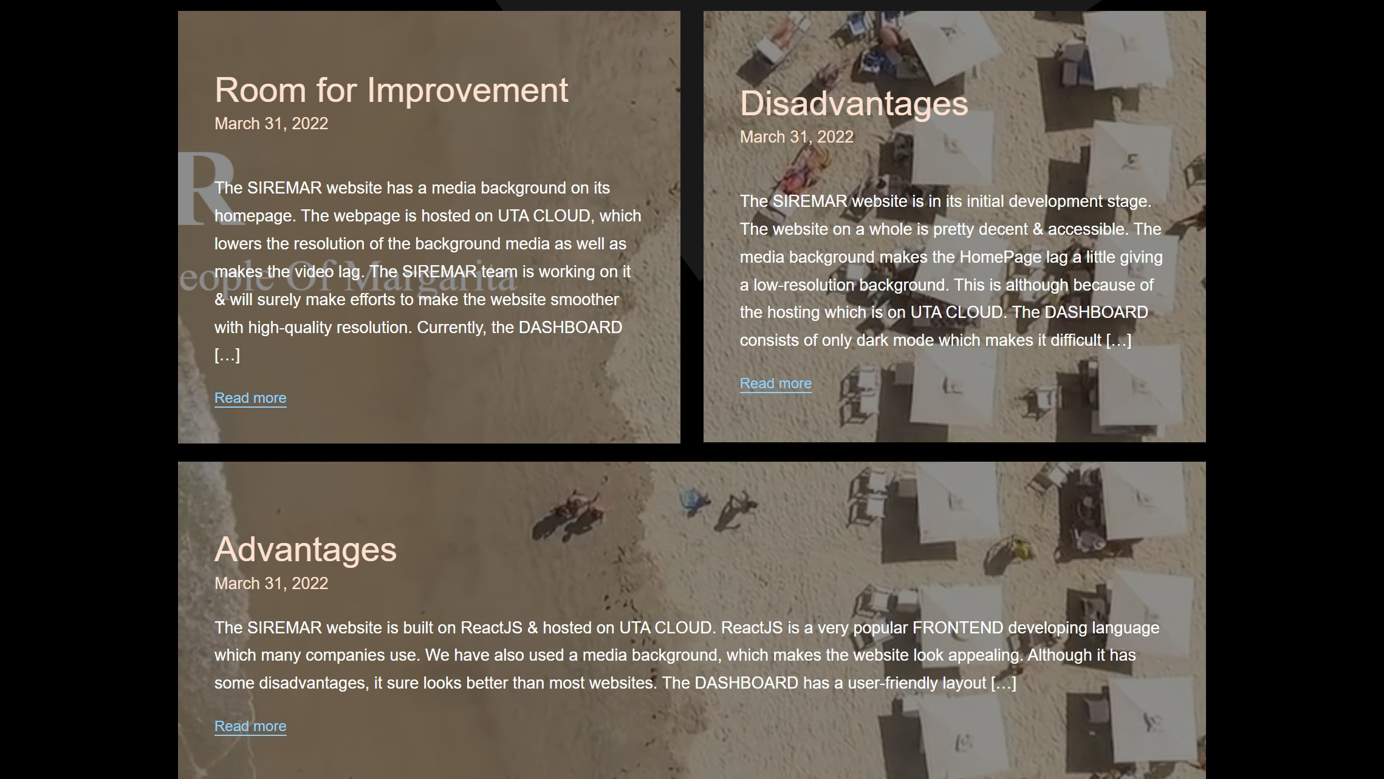
Blog

Slide 17
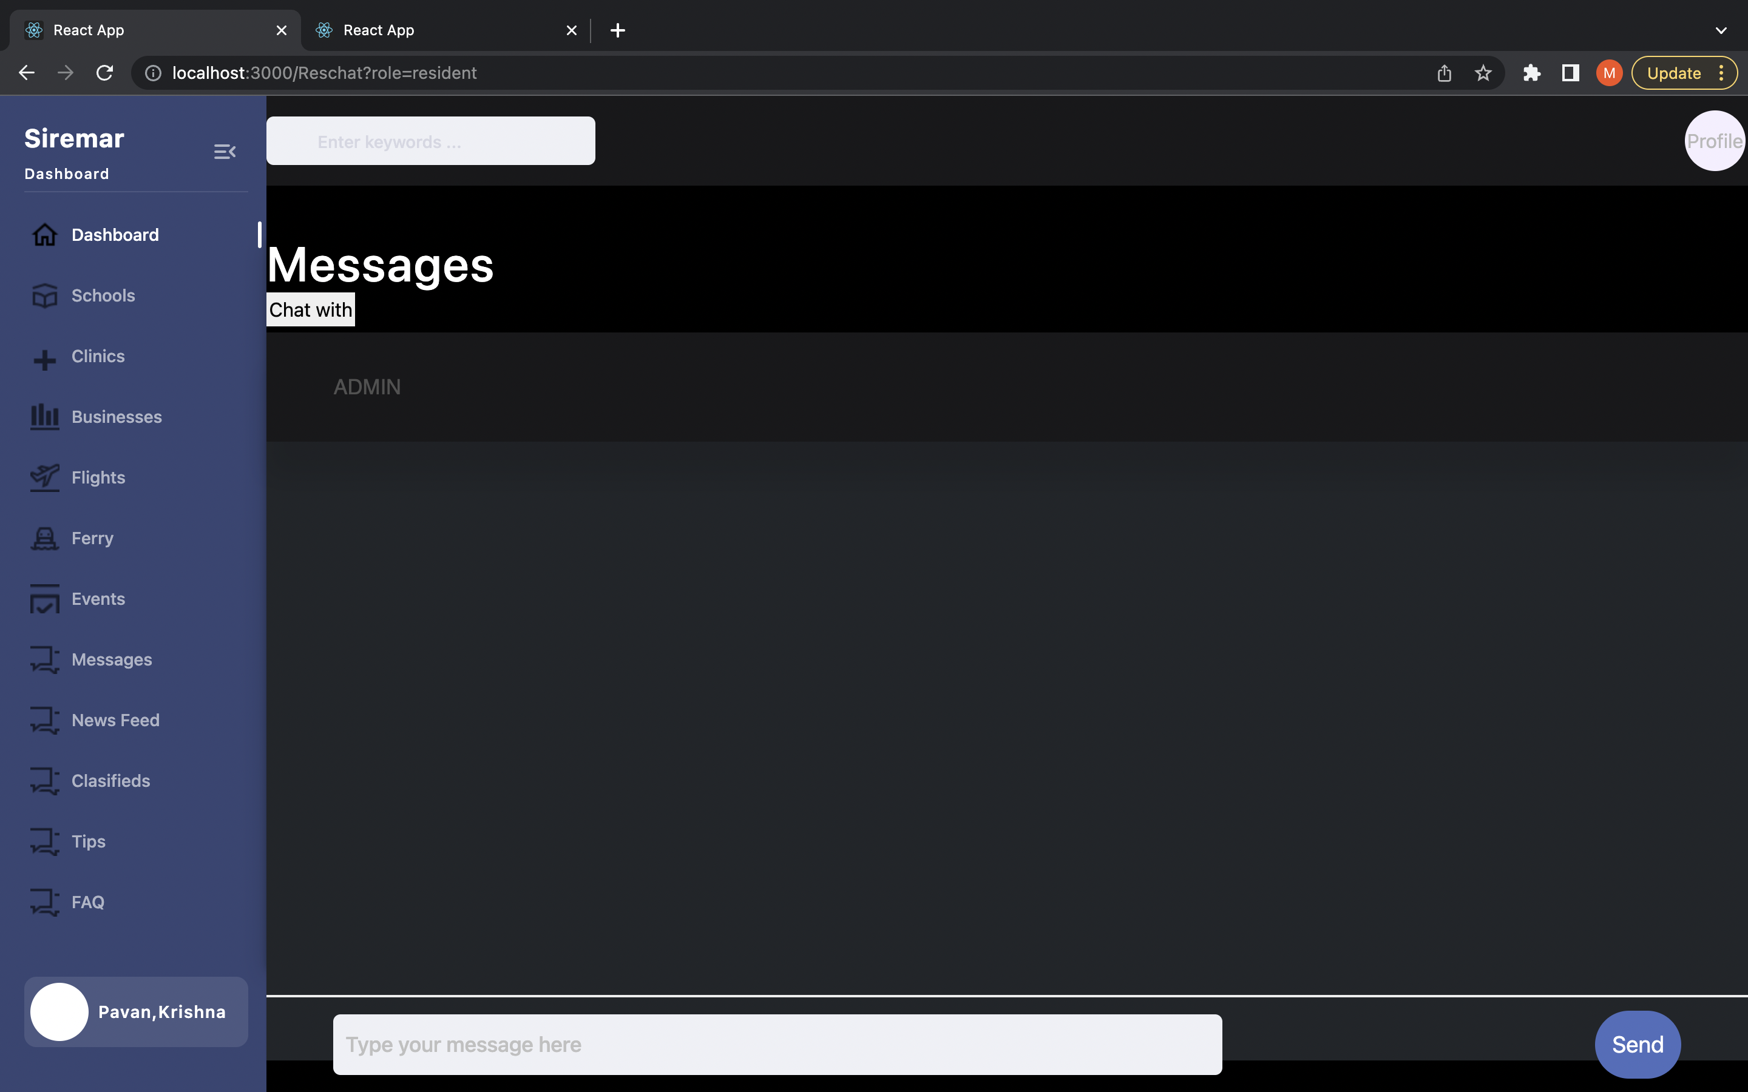
Chat Page

Slide 18
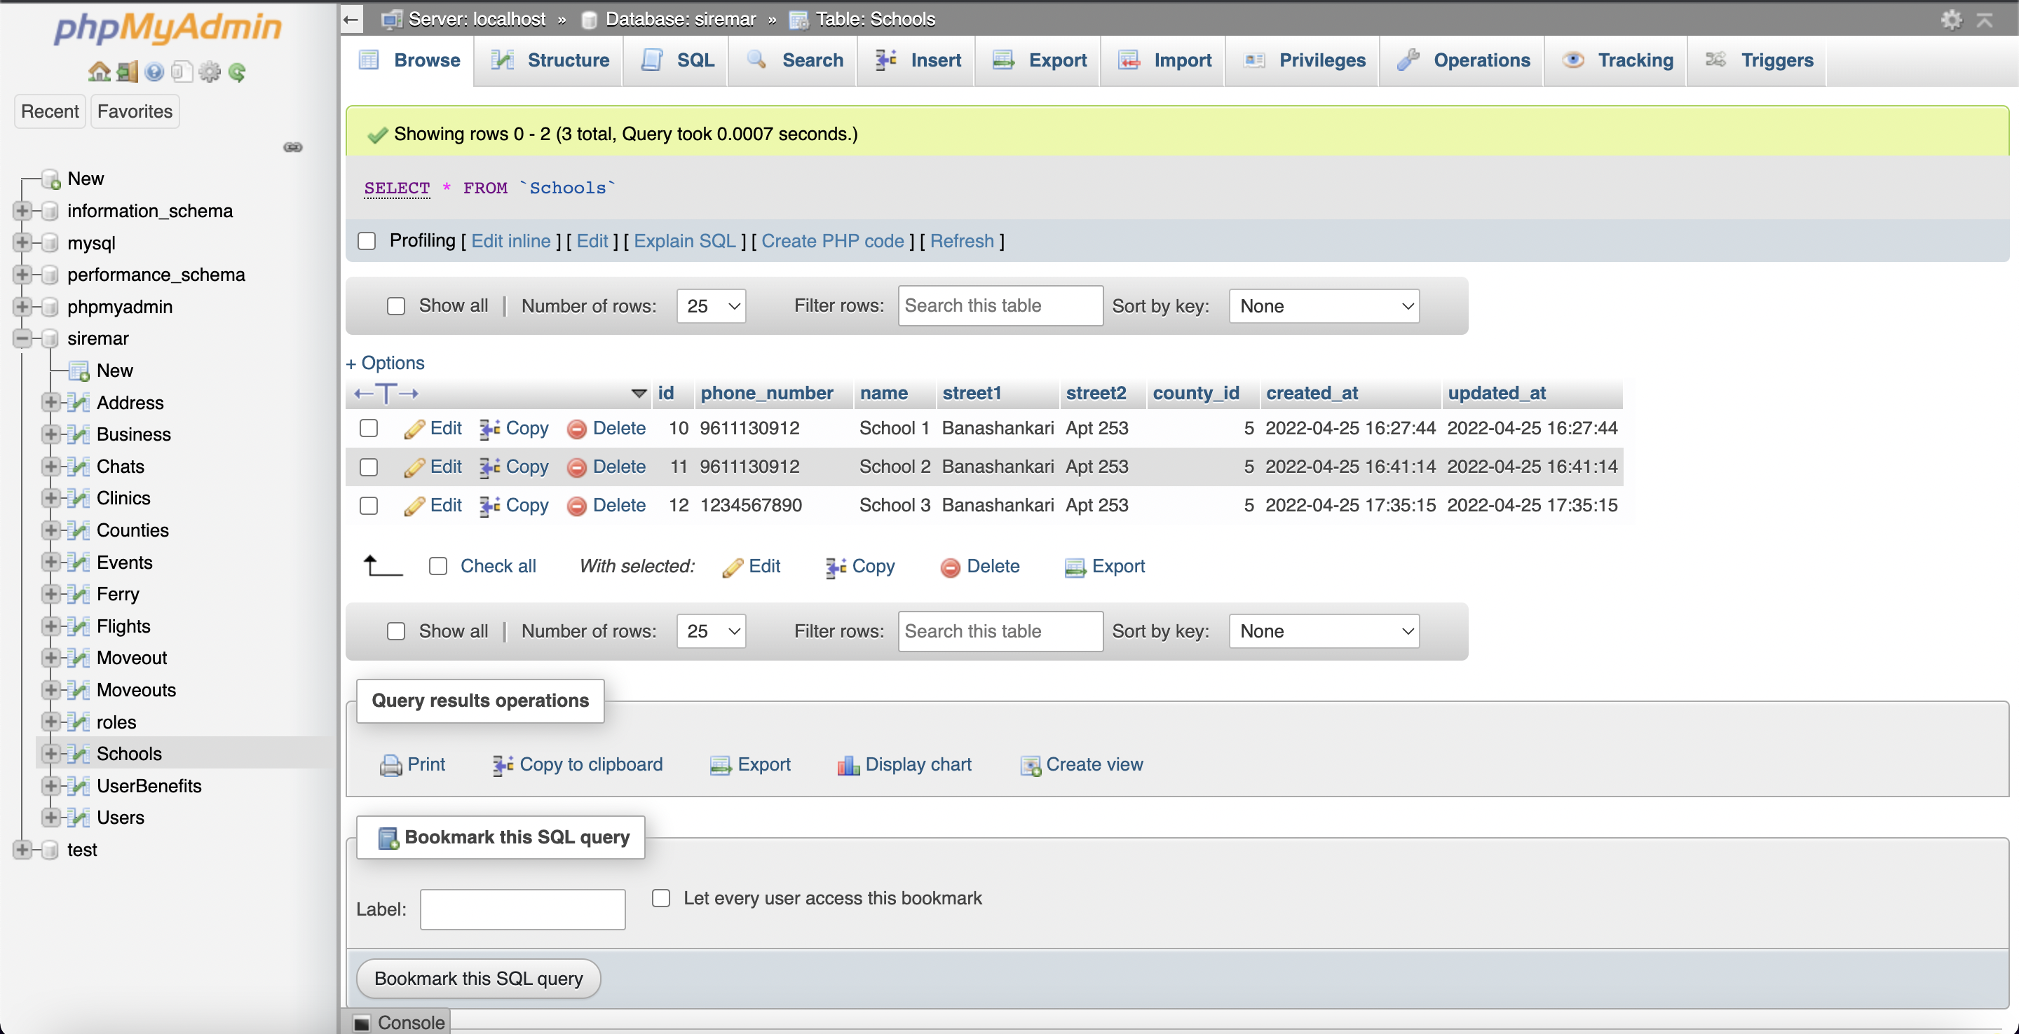
Database

Slide 19
DEMO

Slide 20
Challenges
Working as a Team with people who we did not know before the start of this semester, fixing times and having our meetings was also a challenge.
Learning languages which are widely used in the industry like ReactJS & Laravel to which our prior exposure was very limited.
Hosting an entire functioning website on cloud services.
Understanding the Requirements took a lot of discussion and Brain Storming.
Designing the Optimum Layout took multiple Iterations.
To make our website work with various browsers and devices, we have a Responsive Design, doing this was quite a challenge for every Page.
Integrating each others work in one single final Project was also a very interesting new challenge for us.

Slide 21
Creative functionalities
We have used a media background, which makes the website look mesmerizing.
We have implemented a TOGGLE button where users can switch between Dark/Light themes.
The DASHBOARD has a user-friendly layout which makes it easy for the residents to use it.
The DASHBOARD also has a TIPS section which helps the residents to have a secure web surfing experience. It also has a FAQ section for the residents where the most frequent queries are answered.
BLOG’s are SEO Optimized to get higher Search Engine Results.
The website has proper use of taglines, intuitive navigation, concise content, and strategic use of visuals.
If the User Creates their account in Person, IE: Though the Admin, The Default Password will be LastName+First 4 Digits of their Phone Number.
Our Design and make is Scalable.

Slide 22
Room for Improvement
The security of the website can be strengthened.
There is always room for a better user experience.
Some minor bugs & errors can be fixed with better testing.
Forgot Password can be added for the user’s, the password can be made a minimum of 8 characters which consist of a combination of uppercase and lowercase letters, numbers and special symbols
Chat can be further improved with “Typing..” feature with Email Notifications.
Event’s to which User’s register can be added to their Google or iCloud Calendar.
Profile Photos can also be added to the Profile of the User.
Website Lead-times can be increased by better Optimization.
If the Resident is created by the Admin then they should reset their password once they login for the first time.

Slide 23
Addition to our Portfolio
Yes! We will add SIREMAR to our Portfolios as it shows our skills as a Front-end and a Full-stack Developer.
Adding ReactJS will be a huge addition to our Portfolios as huge companies like Facebook use ReactJS.
Companies like 9GAG, BBC & Pfizer are using LARAVEL as their web development framework.
The number of active websites using LARAVEL is over 646,000 and counting…

Slide 24

Thank You

